Slide 1

Analyzing the factors impacting Airbnb ratings
London, United Kingdom
(weekends only)
Notes:
How can I, over the next month, determine the top three factors that affect the customer rating of London Airbnb listings based on their attributes to maximize revenue for hosts and provide value for guests?

Slide 2
CONTEXT and scope
Airbnb: popular, but with limitations
A model to separate great listings from average listings
Criteria for success: an accurate prediction model
Notes:
Airbnb's popularity as a hotel alternative highlights the importance of understanding rating factors for hosts to optimize listings and increase value, but the 5-star non-anonymous rating system has limitations in distinguishing exceptional listings.
A constraint for this problem is that As the data itself is from 2019, it is possible that expectations from customers may have changed significantly since the onset of COVID-19. So, there remains a question of whether or not the data will still be relevant upon project completion and can be used by stakeholders.
Via the development of a model to determine how much each attribute of a listing contributes to the listing’s overall rating, we can identify what the most important factors are.
The criteria of success for this project can be measured by the accuracy of the manufactured prediction model and the identification of the most important factors affecting Airbnb ratings.

Slide 3
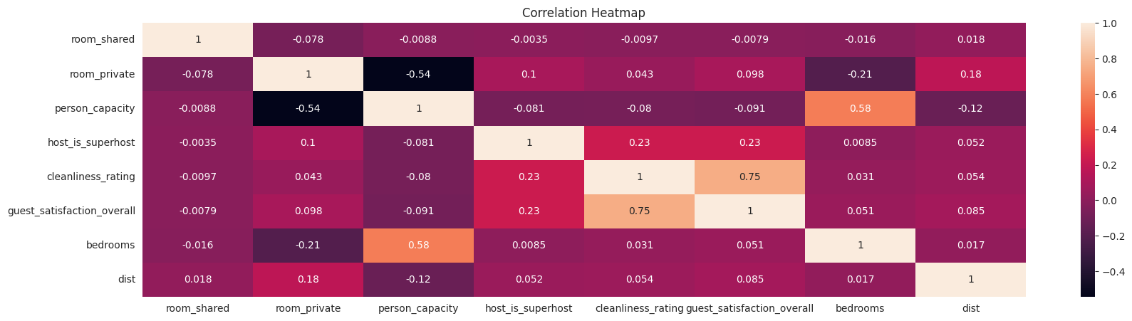
Correlation
Comparing all attributes
Notes:
Host is super host
Cleanliness
Room private
Host and room are boolean so I had to convert to 1s and 0s for purposes of determining making predictions

Slide 4
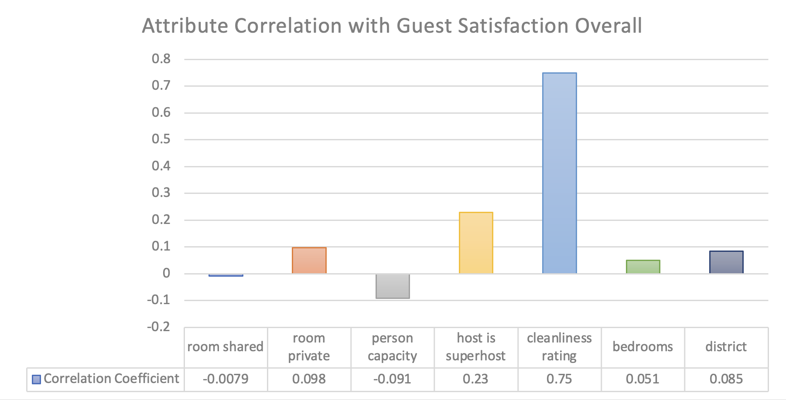
Correlation
Attribute correlation with guest satisfaction
Cleanliness ('cleanliness_rating')
Private room ('room_private')
Superhost ('host_is_superhost')

Slide 5
Statistical significance
Independent Variable | Coefficient | Standard Error | T-statistic | P > |t| | [0.025 | 0.975]
room_private | 2.0166 | 0.218 | 9.239 | 0.000 | 1.589 | 2.444
host_is_superhost | 0.3694 | 0.296 | 1.247 | 0.213 | -0.211 | 0.950
cleanliness_rating | 9.7245 | 0.018 | 541.342 | 0.000 | 9.689 | 9.760
Having a private room or a high cleanliness rating has statistically significant (positive) effects on a listing's overall guest satisfaction

Slide 6
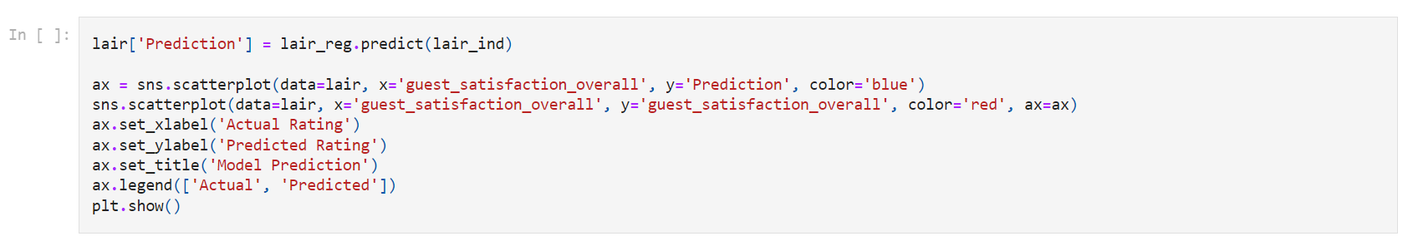
Predicting guest satisfaction

Slide 7
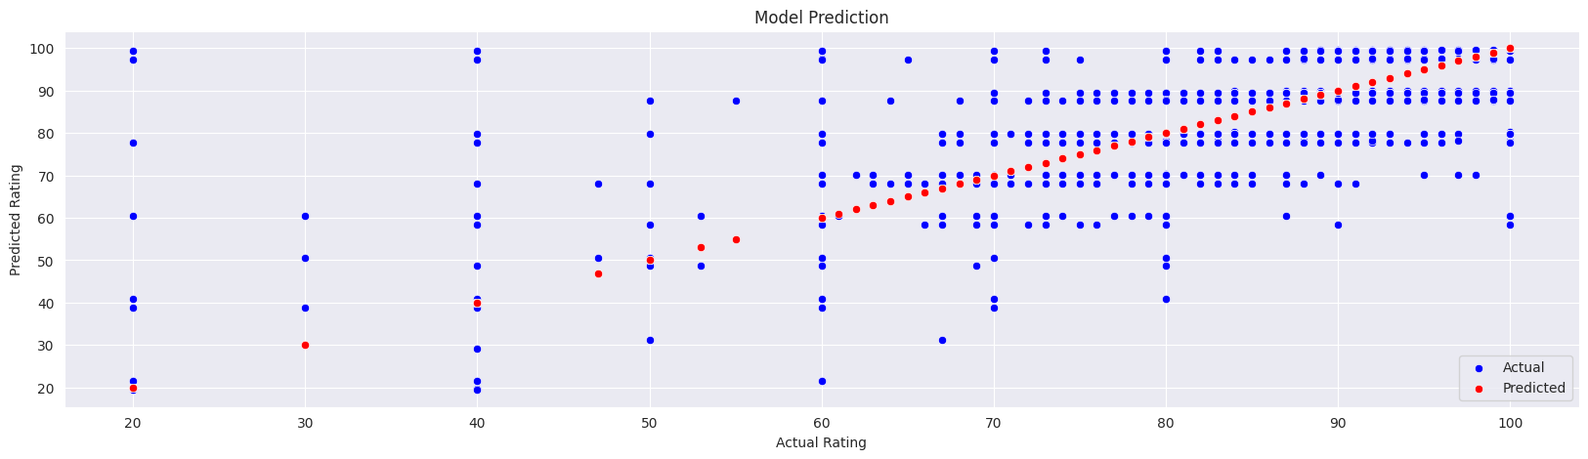
Predicting guest satisfaction
Actual
Predicted

Slide 8
In conclusion: MEASURING SUCCESS
Identify top 3 attributes that affect overall guest satisfaction
Run a significance test for each of the top three attributes
Develop an accurate prediction model

